Slide 1
BCT 2305: Data Communication
Network Layer:
Logical Addressing

Slide 2
IPv4 ADDRESSES
An IPv4 address is a 32-bit address that uniquely and universally defines the connection of a device (for example, a computer or a router) to the Internet.
Need to understand -
Address Space Notations
Classful Addressing
Classless Addressing

Slide 3
Every IP address has two parts:
Network
Host
IP addresses are divided into classes A,B and C to define large, medium, and small networks.
The Class D address class was created to enable multicasting.
IETF reserves Class E addresses for its own research.

Slide 4
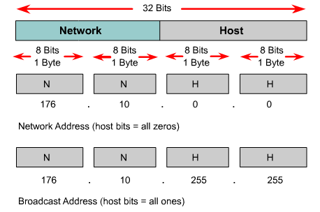
Reserved IP Addresses
Certain host addresses are reserved and cannot be assigned to devices on a network.
An IP address that has binary 0s in all host bit positions is reserved for the network address.
An IP address that has binary 1s in all host bit positions is reserved for the broadcast address.

Slide 5
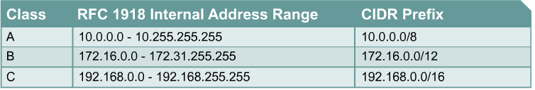
IP Private Addresses
No two machines that connect to a public network can have the same IP address because public IP addresses are global and standardized
Private IP addresses are a solution to the problem of the exhaustion of public IP addresses. Addresses that fall within these ranges are not routed on the Internet backbone:
Connecting a network using private addresses to the Internet requires the usage of NAT

Slide 6
Subnet Mask Address
Determines which part of an IP address is the network field and which part is the host field.
Follow these steps to determine the subnet mask:
1. Express the subnetwork IP address in binary form.
2. Replace the network and subnet portion of the address with all 1s.
3. Replace the host portion of the address with all 0s.
4. Convert the binary expression back to dotted-decimal notation.

Slide 7
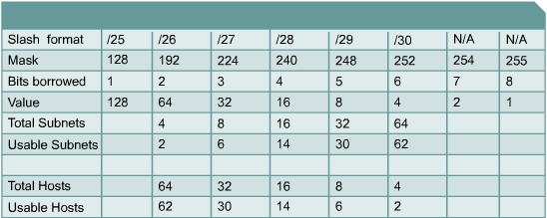
Establishing the Subnet Mask Address
To determine the number of bits to be used, the network designer needs to calculate how many hosts the largest subnetwork requires and the number of subnetworks needed.

Slide 8
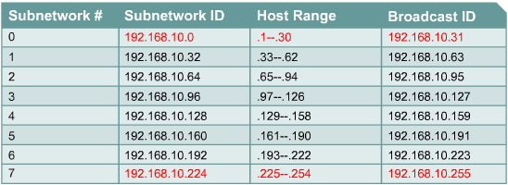
Subnetting example

Slide 9

Note
An IPv4 address is 32 bits long.
The IPv4 addresses are unique and universal (all nodes connecting Internet must have IP addresses).
The address space of IPv4 is 2³² or 4,294,967,296. But is wasted and also getting depleted. Hence classless use and … ipv6.

Slide 10
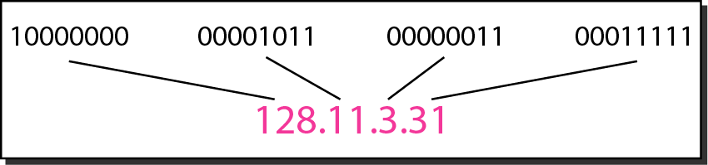
Figure 19.1 Dotted-decimal notation and binary notation for an IPv4 address

Slide 11
Example 19.1
Change the following IPv4 addresses from binary notation to dotted-decimal notation.
Solution
We replace each group of 8 bits with its equivalent decimal number and add dots for separation.

Slide 12
Example 19.2
Change the following IPv4 addresses from dotted-decimal notation to binary notation.
Solution
We replace each decimal number with its binary equivalent

Slide 13
Example 19.3
Find the error, if any, in the following IPv4 addresses.
Solution
a. There must be no leading zero (045).
b. There can be no more than four numbers.
c. Each number needs to be less than or equal to 255.
d. A mixture of binary notation and dotted-decimal notation is not allowed.

Slide 14
Note
In classful addressing, the address space is divided into five classes:
A, B, C, D, and E.

Slide 15
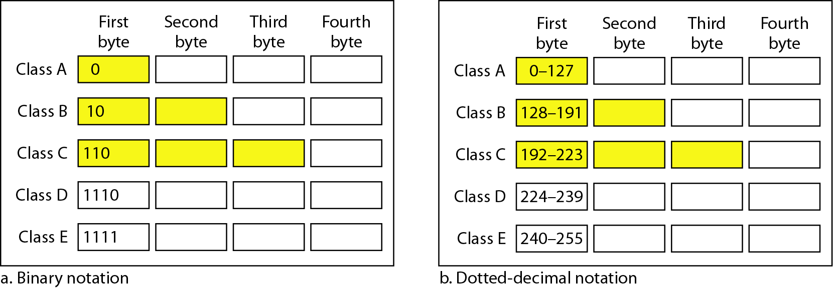
Figure 19.2 Finding the classes in binary and dotted-decimal notation
Class D: multicast
Class E: reserved

Slide 16
Example 19.4
Find the class of each address.
a. 00000001 00001011 00001011 11101111
b. 11000001 10000011 00011011 11111111
c. 14.23.120.8
d. 252.5.15.111
Solution
a. The first bit is 0. This is a class A address.
b. The first 2 bits are 1; the third bit is 0. This is a class C address.
c. The first byte is 14; the class is A.
d. The first byte is 252; the class is E.

Slide 17
Table 19.1 Number of blocks and block size in classful IPv4 addressing

Slide 18
Note
In classful addressing, a large part of the available addresses were wasted.

Slide 19
Note
Classful addressing, which is almost obsolete, is replaced with classless addressing. CIDR prefix

Slide 20
Note
In IPv4 addressing, a block of addresses can be defined as
x.y.z.t /n
in which x.y.z.t defines one of the addresses and the /n defines the mask.
Usually, x.y.z.t is the first address in the address block

Slide 21
Note
The first address in the block can be found by setting the rightmost 32 − n bits to 0s.

Slide 22
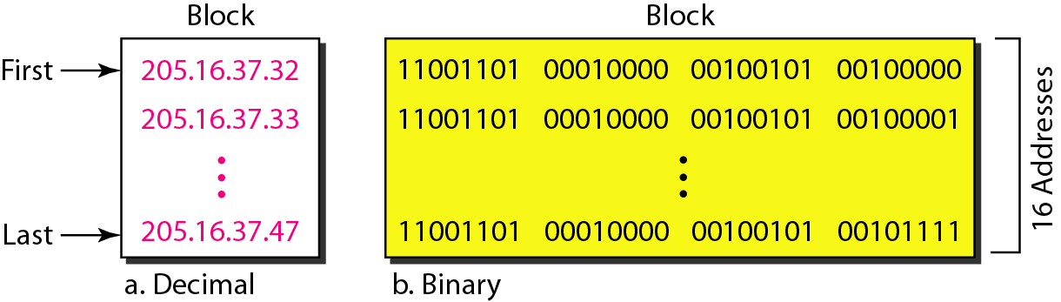
Figure 19.3 A block of 16 addresses granted to a small organization
We can see that the restrictions are applied to this block. The addresses are contiguous. The number of addresses is a power of 2 (16 = 2⁴). This block of IP addresses is represented by:
205.16.37.32/28

Slide 23
Example 19.6
A /28 block of addresses is granted to a small organization. We know that one of the addresses is 205.16.37.39. What is the first address in the block? What is its x.y.z.t/n representation?
Solution
The binary representation of the given address is
11001101 00010000 00100101 00100111
If we set 32−28 rightmost bits to 0, we get
11001101 00010000 00100101 0010000 0
or 205.16.37.32
The block representation is 205.16.37.32/28

Slide 24
Note
The last address in the block can be found by setting the rightmost 32 − n bits to 1s.

Slide 25
Example 19.7
Find the last address for the block in Example 19.6.
Solution
The binary representation of the given address is
11001101 00010000 00100101 00100111
If we set 32 − 28 rightmost bits to 1, we get
11001101 00010000 00100101 00101111
or
205.16.37.47
This is actually the block shown in Figure 19.3.

Slide 26
Note
The number of addresses in the block can be found by using the formula 2^{32−n}.

Slide 27
Example 19.9
Another way to find the first address, the last address, and the number of addresses is to represent the mask as a 32-bit binary (or 8-digit hexadecimal) number. This is particularly useful when we are writing a program to find these pieces of information. In Example 19.5 the /28 can be represented as
11111111 11111111 11111111 11110000
(twenty-eight 1s and four 0s).
Find
a. The first address
b. The last address

Slide 28
Example 19.9 (continued)
Solution
a. The first address can be found by ANDing the given addresses with the mask. ANDing here is done bit by bit. The result of ANDing 2 bits is 1 if both bits are 1s; the result is 0 otherwise.

Slide 29
Example 19.9 (continued)
b. The last address can be found by ORing the given addresses with the complement of the mask. ORing here is done bit by bit. The result of ORing 2 bits is 0 if both bits are 0s; the result is 1 otherwise. The complement of a number is found by changing each 1 to 0 and each 0 to 1.

Slide 30
Figure 19.4 A network configuration for the block 205.16.37.32/28

Slide 31
Note
The first address in a block is normally not assigned to any device; it is used as the network address that represents the organization to the rest of the world.

Slide 32
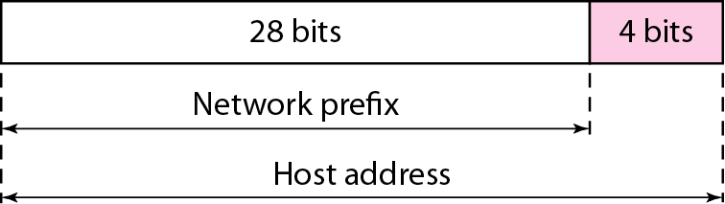
Figure 19.6 hierarchy in IP addressing

Slide 33
Note
Each address in the block can be considered as a two-level hierarchical structure: the leftmost n bits (prefix) define the network;
the rightmost 32 − n bits define the host.

Slide 34
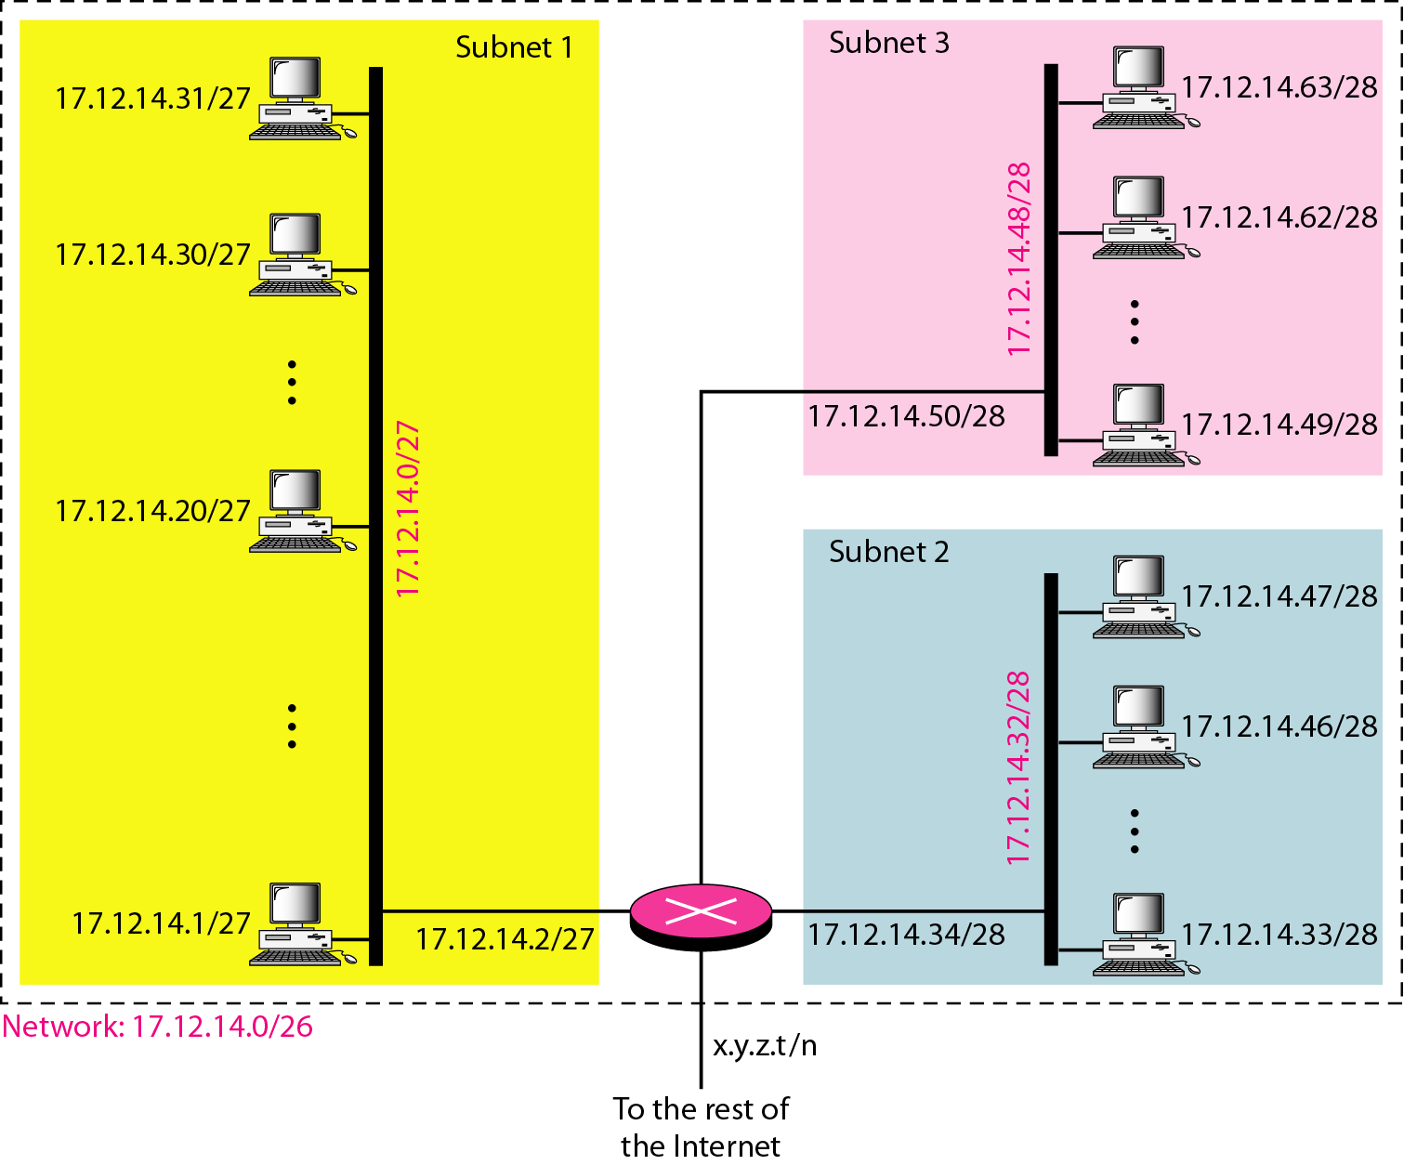
Figure 19.7 Configuration and addresses in a subnetted network

Slide 35
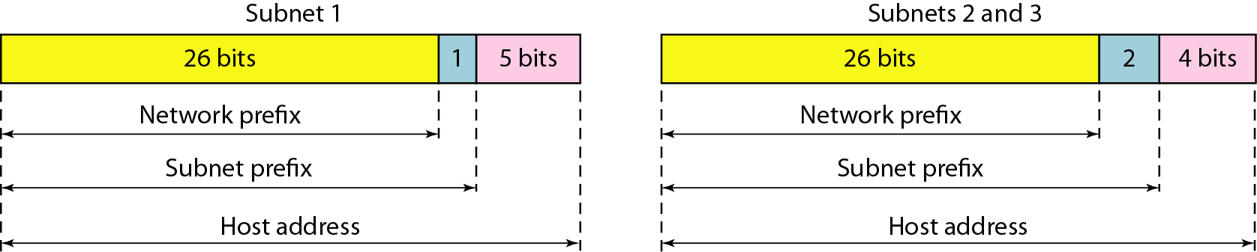
Figure 19.8 Three-level hierarchy in an IPv4 address

Slide 36
Example 19.10
An ISP is granted a block of addresses starting with 190.100.0.0/16 (65,536 addresses). The ISP needs to distribute these addresses to three groups of customers as follows:
a. The first group has 64 customers; each needs 256 addresses.
b. The second group has 128 customers; each needs 128 addresses.
c. The third group has 128 customers; each needs 64 addresses.
Assume the blocks of IPs are sequentially assigned. Design the subblocks and find out how many addresses are still available after these allocations.

Slide 37
Example 19.10 (continued)
Solution
Figure 19.9 shows the situation.
Group 1
For this group, each customer needs 256 addresses. This means that 8 (log2 256) bits are needed to define each host. The prefix length is then 32 − 8 = 24. The addresses are

Slide 38
Example 19.10 (continued)
Group 2
For this group, each customer needs 128 addresses. This means that 7 (log2 128) bits are needed to define each host. The prefix length is then 32 − 7 = 25. The addresses are

Slide 39
Example 19.10 (continued)
Group 3
For this group, each customer needs 64 addresses. This means that 6 (log₂64) bits are needed to each host. The prefix length is then 32 − 6 = 26. The addresses are
Number of granted addresses to the ISP: 65,536
Number of allocated addresses by the ISP: 40,960
Number of available addresses: 24,576

Slide 40
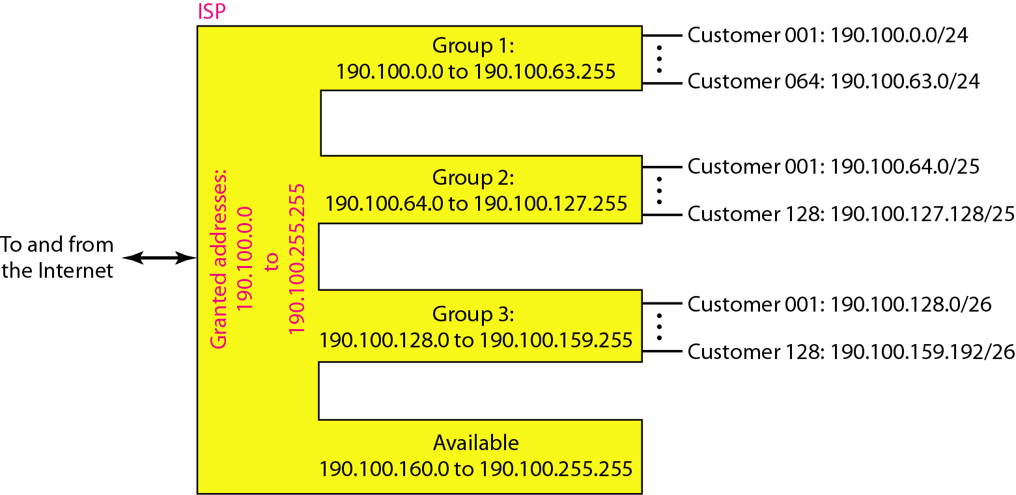
Figure 19.9 An example of address allocation and distribution by an ISP

Slide 41
Another Example on Subnetting
An ISP needs to allocate three subnets: Subnet 1, Subnet 2, and Subnet 3 with its acquired IP block of 223.1.17.0/24. Subnet 1 is required to support 63 interfaces, Subnet 2 is to support at least 40 interfaces, and Subnet 3 is to support at least 95 interfaces. In addition, values of IP addresses have the relationship: Subnet 1 < Subnet 2 < Subnet 3.
Provide three network addresses ( of the form a.b.c.d/x) that satisfy these constraints.

Slide 42
Subnetting
223.1.17.0/24, ip addresses are 2^(32-24) = 256
Subnet 1 needs 2^6=64, 223.1.17.0/26
last address: 223.1.17.63
Subnet 2 needs 2^6=64, 223.1.17.64/26
last address: 223.1.17.127
Subnet 3 needs 2^7 = 128, 223.1.17.128/25
19.42

Slide 43
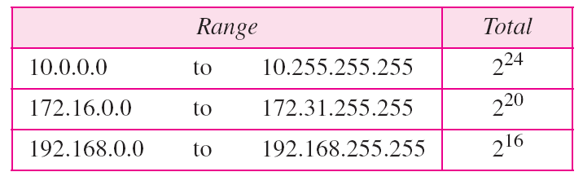
Table 19.3 Addresses for private networks
Home used wireless router usually uses 192.168.1.0/24
or 192.168.0.0/24 IP block

Slide 44
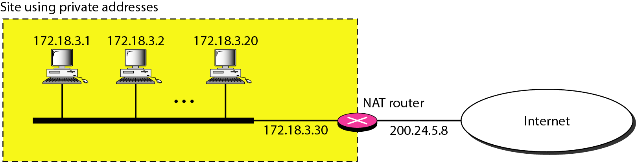
Figure 19.10 A NAT implementation

Slide 45
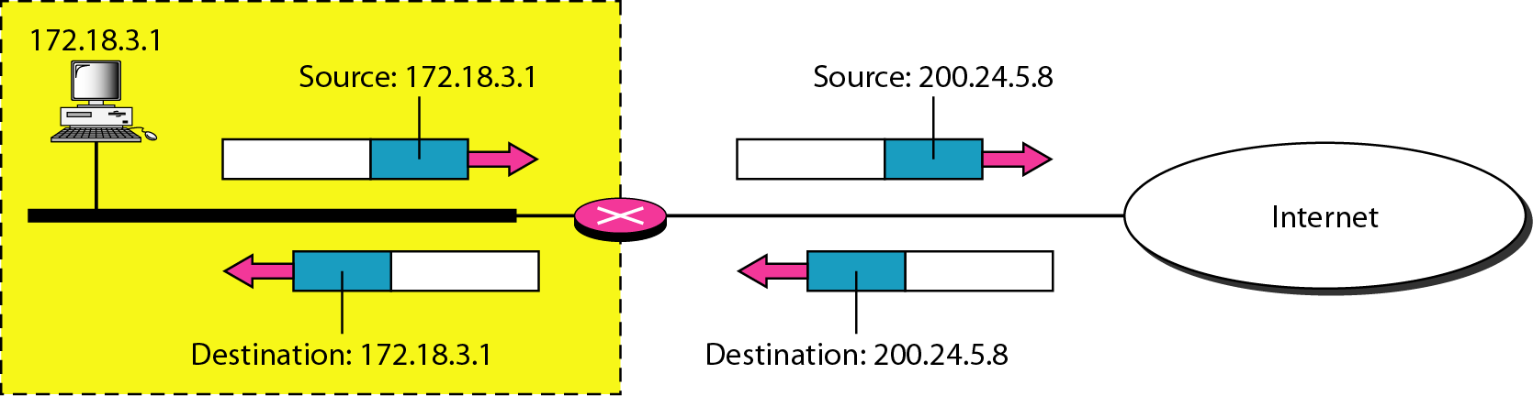
Figure 19.11 Addresses in a NAT

Slide 46
Table 19.4 Five-column translation table

Slide 47
19-2 IPv6 ADDRESSES
Despite all short-term solutions, address depletion is still a long-term problem for the Internet. This and other problems in the IP protocol itself have been the motivation for IPv6.
Note
An IPv6 address is 128 bits long.

Slide 48
Questions?

